Slide 1
WP Summer Institute Day 1 Agenda
9:00-9:15: Balmurli Natrajan introduces the UCC 2.0 in room University Commons room 211
9:15-10:30: Liz Brown facilitates a pedagogy workshop on designing courses to engage students to be critical thinkers through experimental learning which aligns with their lived experiences and specific learning goals in room UC 211
10:30-11:30: Quality Matters by Pete Mandik in room UC 211
11:30-12:00: Jonathan Lincoln and Josh Powers discuss the UCC 2.0 vision/process in room UC 211
12:00: Balmurli Natrajan shares specifics about the UCC 2.0 during lunch in room UC 211
12:30-3:00 UCC area-specific working groups facilitated by UCC reviewers in breakout rooms
UCC 168 A Critical Thinking (Bruce Williams, Andy Gladfelter and Miryam Wahrman)
UCC 168 B Digital Literacies (Angie Yoo and Ruth Maher)
UCC 171 A Decolonization & Justice (Naa-Solo Tettey)
UCC 171 B All other UCC areas (Paul Von Dohlen and Balmurli Natrajan)

Slide 2
Designing UCC 2.0
Course Outlines
Center for Teaching Excellence

Slide 3
Where do we begin?
New UCC 2.0 Area Descriptions/SLOs
NSSE/FSSE data comparing student &
faculty perceptions on teaching/learning
Quality Matters Considerations
Our fields are evolving; our students are as well

Slide 4
2023 NSSE/
FSSE
results
Analyze our teaching practices
Please review the data and share out:
Difference between student perceptions and faculty perceptions
Areas where we could make changes
Areas where we are doing well
Questions we have

Slide 5
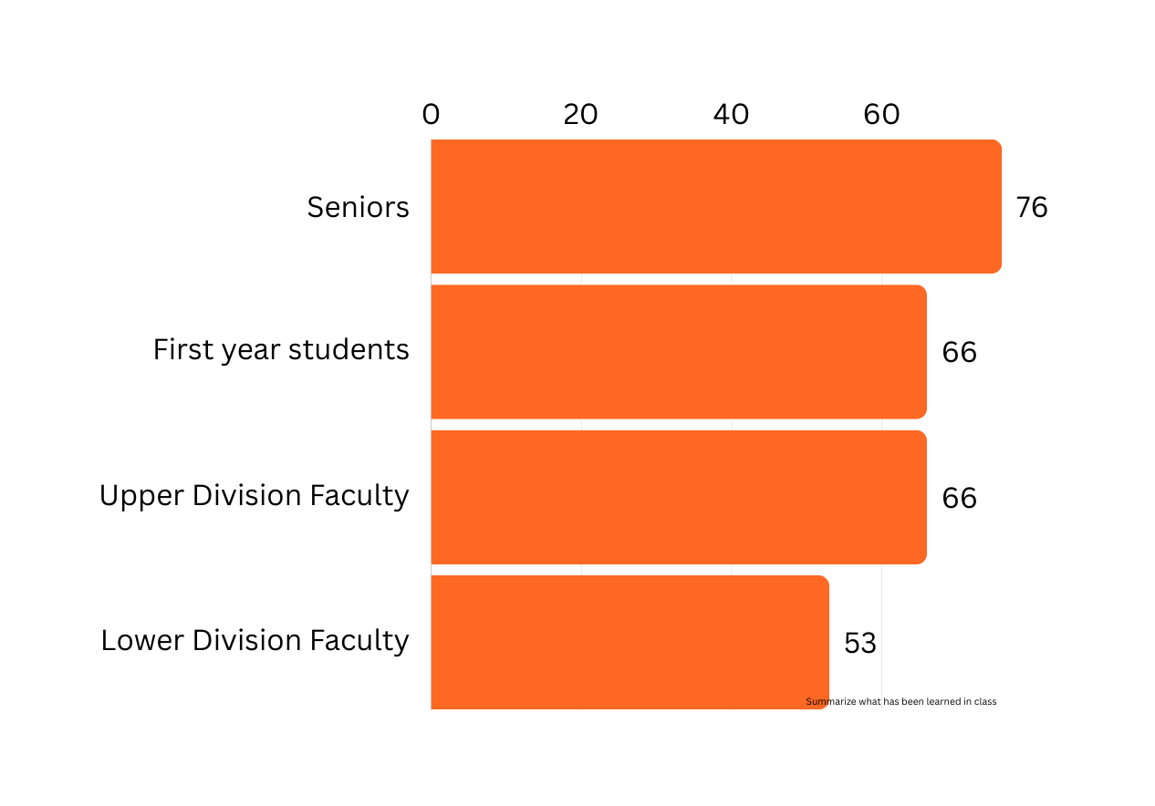
2023 NSSE/
FSSE
results
Summarize What has been Learned from Class Or Class materials
% of NSSE/ FSSE Respondents

Slide 6
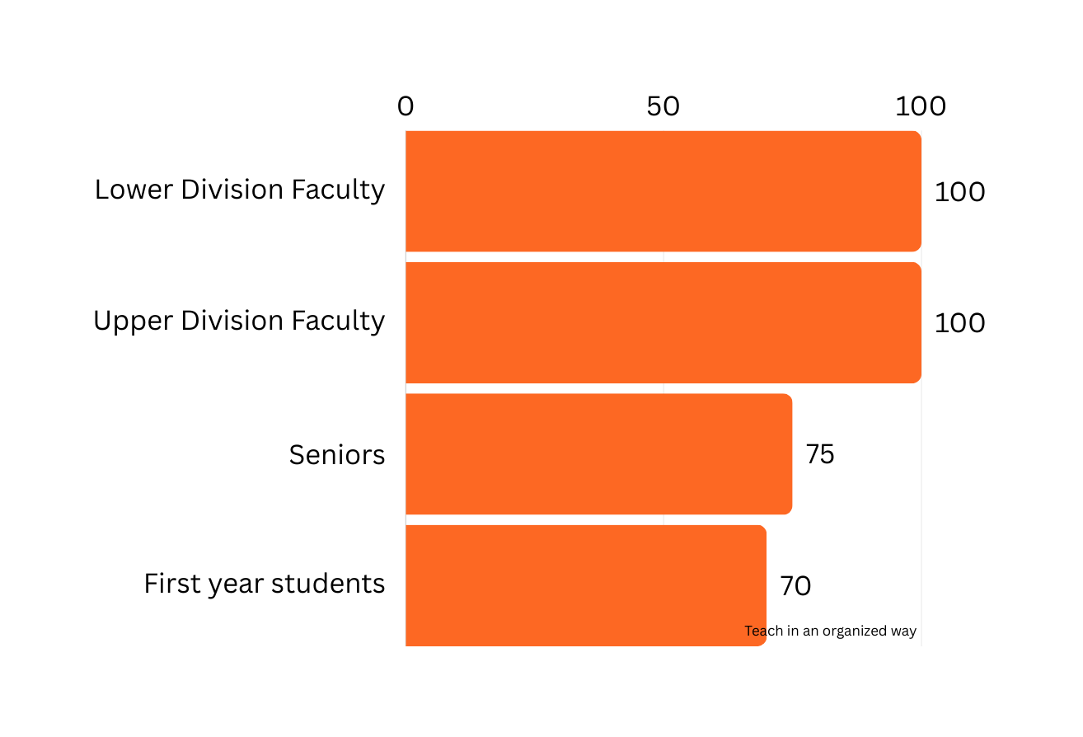
2023 NSSE/
FSSE
results
TEACH Courses in an organized way
% of NSSE/ FSSE Respondents

Slide 7
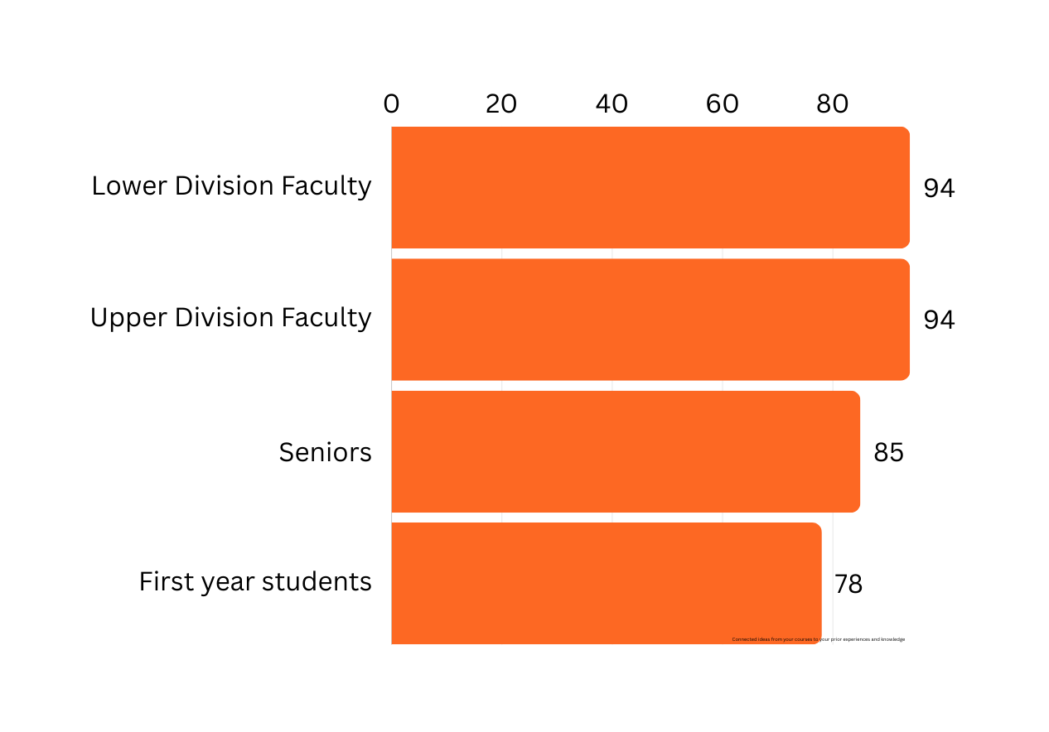
2023 NSSE/
FSSE
results
Connected ideas from your courses to Students’ prior experiences and knowledge
% of NSSE/ FSSE Respondents

Slide 8
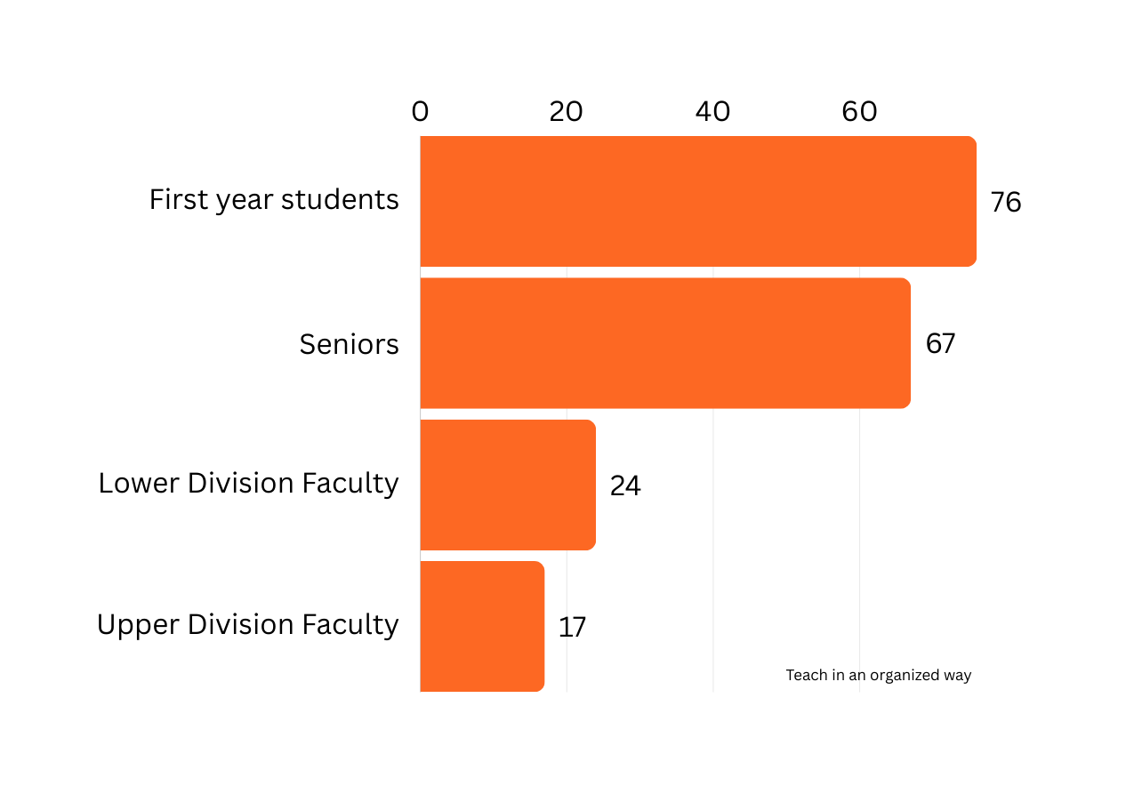
2023 NSSE/
FSSE
results
how much has your coursework emphasized memorizing course material
% of NSSE/ FSSE Respondents

Slide 9
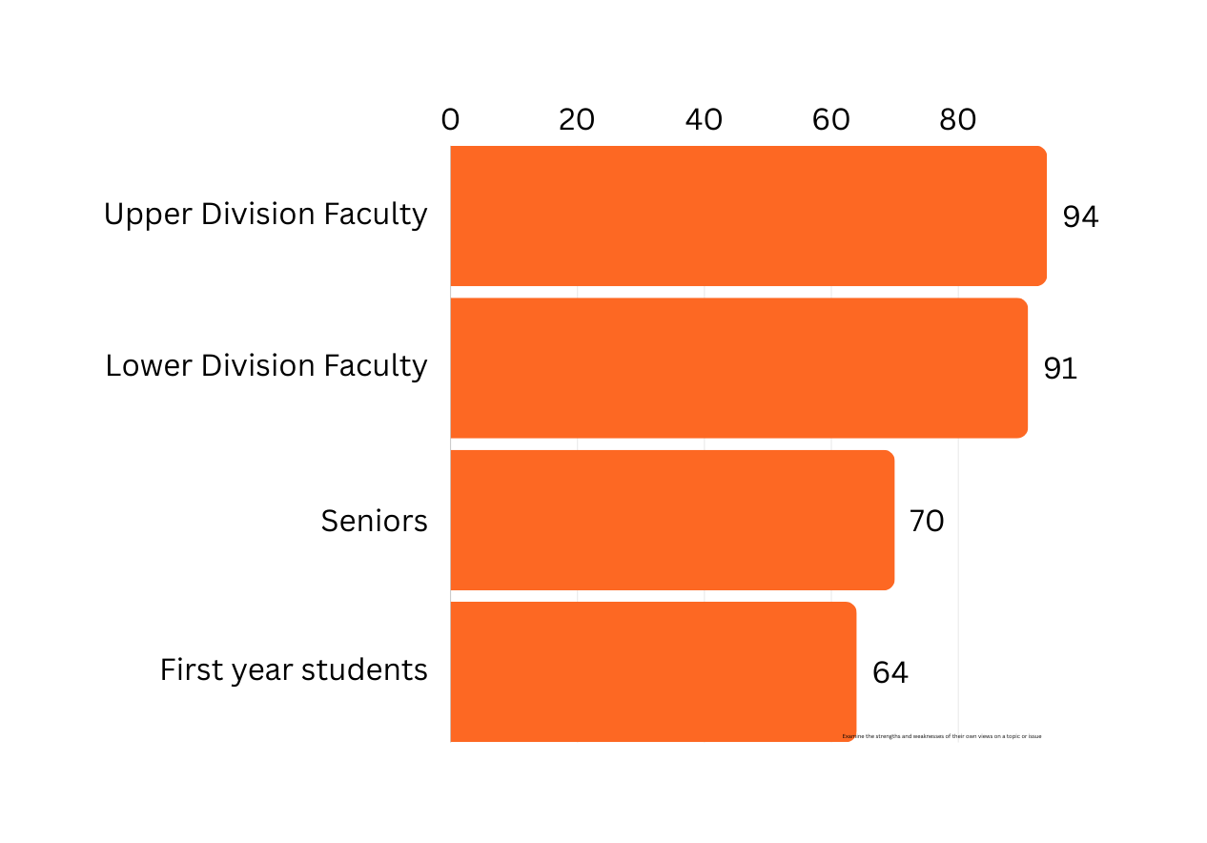
2023 NSSE/
FSSE
results
Examine the strengths and weaknesses of their own views on a topic or issue
% of NSSE/ FSSE Respondents

Slide 10
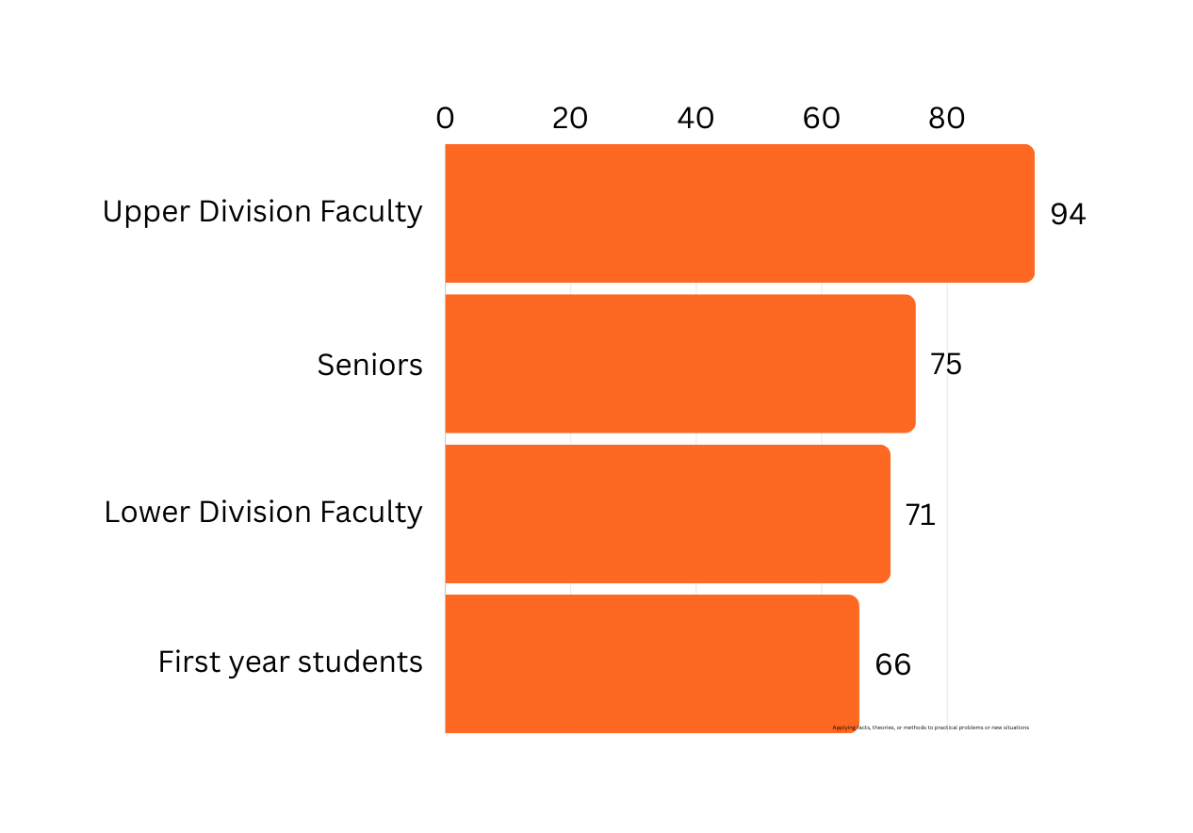
2023 NSSE/
FSSE
results
Applying facts, theories, or methods to practical problems or new situations
% of NSSE/ FSSE Respondents

Slide 11
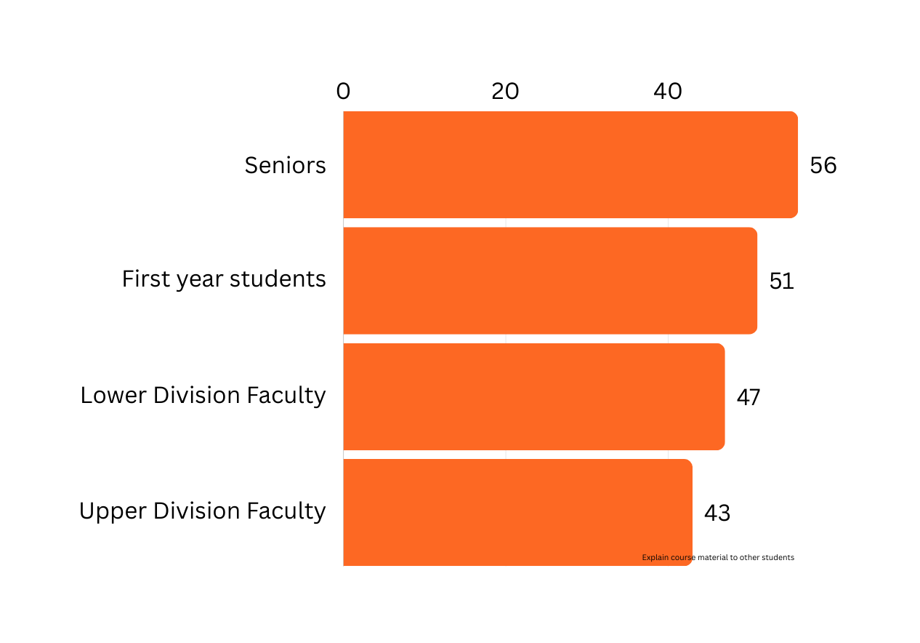
2023 NSSE/
FSSE
results
Explain course material to other students (collaboration)
% of NSSE/ FSSE Respondents

Slide 12
Which strategy will you prioritize?
1
Opportunities for students to summarize course material
2
Improving course organization
3
Connecting course materials to students’ prior knowledge
4
Adjusting assessment to avoid privileging memorization
5
Opportunities for students to examine their own views
6
Opportunities for students to apply facts/theorie to problems
7
Opportunities for students to explain course material to peers

Slide 13
Begin with the end in mind
“Our lessons, units, and courses should be logically inferred from the results sought, not derived from the methods, books, and activities with which we are most comfortable. Curriculum should lay out the most effective ways of achieving specific results… in short, the best designs derive backward from the learnings sought.”
Wiggins and McTighe, 2005
Our Vision
Step 3.
Plan learning experiences and instruction to prepare students for desired results.
Step 1. Identify the desired results: What will students know and do?
Step 2. Determine acceptable evidence:
What will students produce?

Slide 14
Assessment Variety
Bloom’s Taxonomy Types of Knowledge: Revised
Factual Knowledge: Basic elements of a discipline that a student must know and be able to work with to solve problems including basic terminology and specific details and elements.
Conceptual Knowledge: Interrelationships between basic factual knowledge that demonstrate how elements work together, for example, classifications and categories, principles and generalizations, and theories, models, and structures.
Procedural Knowledge: How something is done including the methods of inquiry, skills, algorithms, techniques, and methods needed to investigate, apply, or analyze information.
Metacognitive Knowledge: Awareness and knowledge of one’s own cognition including strategies for learning, contextual and conditional knowledge about cognitive tasks, and self-knowledge.
Anderson, L. W., Krathwohl, D. R., & Bloom, B. S. (2001).

Slide 15
Assessment Variety
Bloom’s Taxonomy
**Bloom’s taxonomy can be used to create Course SLOs, daily SLOs and ensure all domains have been practiced and evaluated.

Slide 16
Assessment Variety
Multiple Choice exams

Slide 17
Assessment Variety
Short answer response, Discussions
Multiple Choice exams

Slide 18
Assessment Variety
Case Study Analysis/ Problem Solving
Short answer response, Discussions
Multiple Choice exams

Slide 19
Assessment Variety
Comparision essay, infographic, PSA
Case Study Analysis/ Problem Solving
Short answer response, Discussions
Multiple Choice exams

Slide 20
Assessment Variety
Debate, Simulation, Critique
Comparision essay, infographic, PSA
Case Study Analysis/ Problem Solving
Short answer response, Discussions
Multiple Choice exams

Slide 21
Assessment Variety
Author an authentic product
Debate, Simulation, Critique
Comparision essay, infographic, PSA
Case Study Analysis/ Problem Solving
Short answer response, Discussions
Multiple Choice exams

Slide 22
Assessment Considerations
Formative Assessment Examples:
Draw a concept map in class to represent a topic
Submit one or two sentences identifying the main point of a class topic
Surveys
Group discussion
Turn and Talk
Anonymous questions
Speed Dating using vocabulary or content from a lecture
Formative Assessment Characteristics:
A low-stakes opportunity for students to practice an assignment that will be graded
Inform your practice right away. Make adjustments if needed
Inform your practice tomorrow
Participation, not grade
Share feedback

Slide 23
Assessment Considerations
WORKLOAD ESTIMATOR
ONLINE FORMATIVE ASSESSMENTS

Slide 24
Align Area SLO with course assessments
Start with your UCC 2.0 Area SLO
Consider how students might practice
the skills within the SLO
Design assessments (formative and summative) to align with the course SLOs.
Use a variety of assessment types
Our Vision
SLO
Formative Assessments
Summative Assessments
AREA E – COMMUNICATION Examine different communication forms and analyze their effectiveness across different contexts, modes, and media
Debate which communication form better supports specific contexts.
Present how modes of communication that are used in different contexts
Rate communication modes
Write to Learn during class
Turn and Discuss with a Peer
Assign different contexts to different students and have them discuss from their perspective

Slide 25
Align Area SLO with course description
Start with your UCC 2.0 Area SLO/description
Underline key words from description and SLOs
When writing your course description, use the same language.
Our Vision
AREA F – CRITICAL THINKING & PROBLEM SOLVING (ARTS & HUMANITIES) AREA DESCRIPTION / AREA OBJECTIVES –
Explore and engage in processes, techniques, and strategies that foster curiosity, promote inquiry, and yield well-reasoned conclusions and solutions concerning humans and the world they live in.
STUDENT LEARNING OBJECTIVES
1. Describe issues or problems from a social, historical, cultural, linguistic, literary, artistic, and/or ethical perspective using information from relevant sources.
2. Analyze and evaluate the underlying factors and assumptions related to the issues or problems, including their validity, plausibility, and/or limiting conditions.
3. Compare differing theoretical perspectives and approaches for understanding and/or resolving the issues or problems. 4. Develop hypotheses and/or frameworks supported by evidence and based on chosen theoretical perspectives for evaluating the issues or problems.
5. Evaluate the implications of the hypotheses and/or frameworks for social policy, behavioral or cultural practices, educational policy, and/or general knowledge.

Slide 26
Align Area SLO with course description
Start with your UCC 2.0 Area SLO/description
Underline key words from description and SLOs
When writing your course description, use the same language.
Our Vision
AREA F – CRITICAL THINKING & PROBLEM SOLVING (ARTS & HUMANITIES) AREA DESCRIPTION / AREA OBJECTIVES –
Explore and engage in processes, techniques, and strategies that foster curiosity, promote inquiry, and yield well-reasoned conclusions and solutions concerning humans and the world they live in.
STUDENT LEARNING OBJECTIVES
1. Describe issues or problems from a social, historical, cultural, linguistic, literary, artistic, and/or ethical perspective using information from relevant sources.
2. Analyze and evaluate the underlying factors and assumptions related to the issues or problems, including their validity, plausibility, and/or limiting conditions.
3. Compare differing theoretical perspectives and approaches for understanding and/or resolving the issues or problems. 4. Develop hypotheses and/or frameworks supported by evidence and based on chosen theoretical perspectives for evaluating the issues or problems.
5. Evaluate the implications of the hypotheses and/or frameworks for social policy, behavioral or cultural practices, educational policy, and/or general knowledge.

Slide 27
Opportunities for students to practice UCC Area SLOs in class
Our Vision

Slide 28
Opportunities for students to practice Area SLOs in class

Slide 29
High Leverage Practices
1
Students summarize course material in their own words
2
Course is organized and students know what to expect
3
Course material connects to students’ prior knowledge
4
Variety of assessments assessing all levels of Bloom’s Taxonomy
5
Students examine their own views using course content
6
Students to apply facts/theorie to problems
7
Students explain course material to peers during class

Slide 30
High Leverage Practices
in lesson planning
FROM TEACHING COLLEGE: THE ULTIMATE GUIDE TO LECTURING, PRESENTING, AND ENGAGING STUDENTS
BY NORMAN ENG
Title/Essential Question:
How can [insert your niche concept/idea here] help you [insert desired outcome]?
Why is [insert your niche concept/idea here] an important part of [insert a competency or skill]?
Why is [insert your niche concept/idea here] important for [insert students’ potential career]?
Objective: Students will be able to:
What will they be able to do? Students will …
How will they accomplish this? By …
How does this benefit them? So that …
4

Slide 31
High Leverage Practices
in lesson planning
FROM TEACHING COLLEGE: THE ULTIMATE GUIDE TO LECTURING, PRESENTING, AND ENGAGING STUDENTS
BY NORMAN ENG
Beginning (Pre-Activity)
Opening: What opening will immediately and appropriately engage students?
Ask a thought-provoking question
Bring up an interesting fact or statistic
Tell a relevant story or anecdote
Use a relevant quote or saying
Start with an analogy (something students already know)
Open with a warm-up activity
Set the stage with a scenario
4

Slide 32
High Leverage Practices
in lesson planning
FROM TEACHING COLLEGE: THE ULTIMATE GUIDE TO LECTURING, PRESENTING, AND ENGAGING STUDENTS
BY NORMAN ENG
Lecture (use responses below to plan lecture)
a. What part of the topic will you focus on? (1–3 only)
b. Why is this topic/concept/idea important?
c. How can you make it relevant, meaningful, and/or easier to understand? (If possible, search for the underlying idea of the topic or the universal experience students can relate to.)
d. How can you apply this topic/concept/idea to a student’s life?
e. How will you deliver your lecture? Will you use slides?
4

Slide 33
High Leverage Practices
in lesson planning
FROM TEACHING COLLEGE: THE ULTIMATE GUIDE TO LECTURING, PRESENTING, AND ENGAGING STUDENTS
BY NORMAN ENG
Lecture (use responses below to plan lecture)
a. What part of the topic will you focus on? (1–3 only)
b. Why is this topic/concept/idea important?
c. How can you make it relevant, meaningful, and/or easier to understand? (If possible, search for the underlying idea of the topic or the universal experience students can relate to.)
d. How can you apply this topic/concept/idea to a student’s life?
e. How will you deliver your lecture? Will you use slides?
4

Slide 34
High Leverage Practices
in lesson planning
FROM TEACHING COLLEGE: THE ULTIMATE GUIDE TO LECTURING, PRESENTING, AND ENGAGING STUDENTS
BY NORMAN ENG
Guided Practice (if applicable; mainly for problem-solving courses, like STEM)
How will you help students practice what you have just taught? Will you pair students? How will you assess their understanding?
Turn-and-talk (with partner)
Middle (Activity)
What activity or activities will you use to deepen students’ understanding? (Use more than one if possible)
· Discussion
· Debate/competition
· Small group work
· Surveys/inventories
· Role-play/perspective-taking
· Demonstration
· Oral presentations
· Case studies
4

Slide 35
High Leverage Practices
in lesson planning
FROM TEACHING COLLEGE: THE ULTIMATE GUIDE TO LECTURING, PRESENTING, AND ENGAGING STUDENTS
BY NORMAN ENG
End (Post-Activity)
How will you assess your students’ understanding of today’s topic/concept/idea(s)?
Reflect/Share
Exit ticket
Quiz/Answering essential question
Will this be done orally or written?
How will you tie the lesson back to the lesson objective or essential question?
Support
What are some obstacles you anticipate? How will you address them?
4

Slide 37
WP Summer Institute Day 1 Agenda
9:00-9:15: Balmurli Natrajan introduces the UCC 2.0 in room University Commons room 211
9:15-10:30: Liz Brown facilitates a pedagogy workshop on designing courses to engage students to be critical thinkers through experimental learning which aligns with their lived experiences and specific learning goals in room UC 211
10:30-11:30: Quality Matters by Pete Mandik in room UC 211
11:30-12:00: Jonathan Lincoln and Josh Powers discuss the UCC 2.0 vision/process in room UC 211
12:00: Balmurli Natrajan shares specifics about the UCC 2.0 during lunch in room UC 211
12:30-3:00 UCC area-specific working groups facilitated by UCC reviewers in breakout rooms
UCC 168 A Critical Thinking (Bruce Williams, Andy Gladfelter and Miryam Wahrman)
UCC 168 B Digital Literacies (Angie Yoo and Ruth Maher)
UCC 171 A Decolonization & Justice (Naa-Solo Tettey)
UCC 171 B All other UCC areas (Paul Von Dohlen and Balmurli Natrajan)

Slide 38
WP Summer Institute Day 1 Agenda
9:00-9:15: Balmurli Natrajan introduces the UCC 2.0 in room University Commons room 211
9:15-10:30: Liz Brown facilitates a pedagogy workshop on designing courses to engage students to be critical thinkers through experimental learning which aligns with their lived experiences and specific learning goals in room UC 211
10:30-11:30: Quality Matters by Pete Mandik in room UC 211
11:30-12:00: Jonathan Lincoln and Josh Powers discuss the UCC 2.0 vision/process in room UC 211
12:00: Balmurli Natrajan shares specifics about the UCC 2.0 during lunch in room UC 211
12:30-3:00 UCC area-specific working groups facilitated by UCC reviewers in breakout rooms
UCC 168 A Critical Thinking (Bruce Williams, Andy Gladfelter and Miryam Wahrman)
UCC 168 B Digital Literacies (Angie Yoo and Ruth Maher)
UCC 171 A Decolonization & Justice (Naa-Solo Tettey)
UCC 171 B All other UCC areas (Paul Von Dohlen and Balmurli Natrajan)

Slide 39
WP Summer Institute Day 1 Agenda
9:00-9:15: Balmurli Natrajan introduces the UCC 2.0 in room University Commons room 211
9:15-10:30: Liz Brown facilitates a pedagogy workshop on designing courses to engage students to be critical thinkers through experimental learning which aligns with their lived experiences and specific learning goals in room UC 211
10:30-11:30: Quality Matters by Pete Mandik in room UC 211
11:30-12:00: Jonathan Lincoln and Josh Powers discuss the UCC 2.0 vision/process in room UC 211
12:00: Balmurli Natrajan shares specifics about the UCC 2.0 during lunch in room UC 211
12:30-3:00 UCC area-specific working groups facilitated by UCC reviewers in breakout rooms
UCC 168 A Critical Thinking (Bruce Williams, Andy Gladfelter and Miryam Wahrman)
UCC 168 B Digital Literacies (Angie Yoo and Ruth Maher)
UCC 171 A Decolonization & Justice (Naa-Solo Tettey)
UCC 171 B All other UCC areas (Paul Von Dohlen and Balmurli Natrajan)

Slide 40
WP Summer Institute Day 1 Agenda
9:00-9:15: Balmurli Natrajan introduces the UCC 2.0 in room University Commons room 211
9:15-10:30: Liz Brown facilitates a pedagogy workshop on designing courses to engage students to be critical thinkers through experimental learning which aligns with their lived experiences and specific learning goals in room UC 211
10:30-11:30: Quality Matters by Pete Mandik in room UC 211
11:30-12:00: Jonathan Lincoln and Josh Powers discuss the UCC 2.0 vision/process in room UC 211
12:00: Balmurli Natrajan shares specifics about the UCC 2.0 during lunch in room UC 211
12:30-3:00 UCC area-specific working groups facilitated by UCC reviewers in breakout rooms
UCC 168 A Critical Thinking (Bruce Williams, Andy Gladfelter and Miryam Wahrman)
UCC 168 B Digital Literacies (Angie Yoo and Ruth Maher)
UCC 171 A Decolonization & Justice (Naa-Solo Tettey)
UCC 171 B All other UCC areas (Paul Von Dohlen and Balmurli Natrajan)

