Slide 1


Yes we can!
A hands-on approach to
Open Educational Resources
NJEDge Instructor Showcase
2019-02-22

Slide 2

Introductions!
Robert Alan Harris, Assistant Director
Center for Teaching with Technology
973 720-2451 – harrisr@wpunj.edu
Your name, school, subjects!

Slide 3

What are
Open Educational Resources?
Open Educational Resources (OER) are teaching, learning and research materials in any medium – digital or otherwise – that reside in the public domain or have been released under an open license that permits no-cost access, use, adaptation and redistribution by others with no or limited restrictions.
https://en.unesco.org/themes/building-knowledge-societies/oer
Neither the concept or the need is new, but both the demand for change and the tools to effect it are both developing rapidly.
Notes:
Open Educational Resources (OER) are teaching, learning and research materials in any medium – digital or otherwise – that reside in the public domain or have been released under an open license that permits no-cost access, use, adaptation and redistribution by others with no or limited restrictions.

Slide 4
History
The term "open educational resources" was first adopted at UNESCO's 2002 Forum on the Impact of Open Courseware for Higher Education in Developing Countries.
“Open Educational Resources (OER) are teaching, learning and research materials in any medium – digital or otherwise – that reside in the public domain or have been released under an open license that permits no-cost access, use, adaptation and redistribution by others with no or limited restrictions.”
https://en.unesco.org/themes/building-knowledge-societies/oer
Notes:
OERs help improve education across the globe. They are important for developing countries, where many students may not be able to afford textbooks, where access to classrooms may be limited, and where teacher-training programs may be lacking. They are also important in wealthy industrialized countries, where they can offer significant cost savings.

Slide 5
Why are we using
Open Educational Resources?
The cost of textbooks has continued to impact students in higher education. Students have reported that they make decisions on which courses to take based on the specific cost of textbooks . . . We found that 66% of students at this institution have not purchased a textbook due to cost. We also discovered that 91% of faculty at this institution would be willing to use OER alternatives and that 53% of them would welcome assistance identifying and adapting materials for their course
Analysis of Student and Faculty Perceptions of Textbook Costs in Higher Education, Martin et. al., Open Praxis, 2017
Notes:
OER can offer drastic savings in the cost of education. Some of your students who otherwise cannot afford to buy expensive textbooks or other course materials will enjoy this affordable option when taking your course.

Slide 6
Studies
Hilton, et. Al., 2016
“Open educational resources and college textbook choices: a review of research on efficacy and perceptions.”
Education Technology Research Development, 64(4) · February 2016
[A synthesis of] the results of 16 studies that examine . . . the influence of OER on student learning outcomes in higher education settings or . . . the perceptions of college students and instructors of OER . . . indicate that students generally achieve the same learning outcomes when OER are utilized and . . . save significant amounts of money. Studies across a variety of settings indicate that both students and faculty are generally positive regarding OER.
Notes:
The collective results of the 16 studies discussed in this article provide timely information given the vast amount of money spent on traditional textbooks. Because students and faculty members generally find that OER are comparable in quality to traditional learning resources, and that the use of OER does not appear to negatively influence student learning, one must question the value of traditional textbooks. If the average college student spends approximately $1000 per year on textbooks and yet performs scholastically no better than the student who utilizes free OER, what exactly is being purchased with that $1000?

Slide 7
Studies
Fischer, L. et. al. (2015)
"A multi-institutional study of the impact of open textbook adoption on the learning outcomes of post-secondary students"
Journal of Computing in Higher Education 27(3), 159-172
Begins with a comprehensive review if literature citing the results of similar studies which is itself worth the price of admission.
1. Comparing students who [use / don't use] OER is there a difference in the number of students who complete a course?
Result: NO significant difference
2. Comparing students who [use / don't use] OER is there a difference in the number of students who pass a course with a C- or better grade? NO
3. Comparing students who [use / don't use] OER is there a difference in the course grade? NO

Slide 8

Studies
Judith, K. et al., 2016
“Assessing the potential for openness: A framework for examining course-level OER implementation in higher education”
Education Policy Analysis Archives, March 2016
Drawing on case studies of OER initiatives globally, the article discusses field-tested solutions to addressing those challenges [and concludes with a] framework that highlights the importance of weighing the efficiencies afforded by a higher level of institutional control in OER implementation efforts, with the need for individual freedom on behalf of faculty to creatively use and adapt OER.

Slide 9

https://creativecommons.org/
Share, Collaborate, Remix, Reuse
“We’re changing the way people share around the world with our Global Community and 1.4 billion pieces of content under our simple, easy-to-use open licenses.”
Creative Commons is the leading organization supporting the global movement for sharing and collaboration. We create, maintain, and promote the Creative Commons licenses — free, international, easy-to-use copyright licenses that are the standard for enabling sharing and remix.
Notes:
Creative Commons helps you legally share your knowledge and creativity to build a more equitable, accessible, and innovative world. We unlock the full potential of the internet to drive a new era of development, growth and productivity.

Slide 10
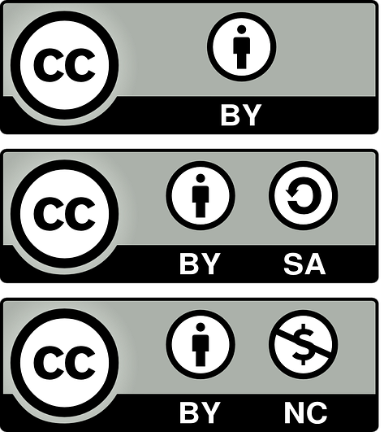

Creative Commons
Licensing
Attribution
This license lets others distribute, remix, tweak, and build upon your work, even commercially, as long as they credit you for the original creation. This is the most accommodating of licenses offered. Recommended for maximum dissemination and use of licensed materials.
Notes:
This license lets others distribute, remix, tweak, and build upon your work, even commercially, as long as they credit you for the original creation. This is the most accommodating of licenses offered. Recommended for maximum dissemination and use of licensed materials.

Slide 11
Creative Commons
Licensing
Attribution – ShareAlike
This license lets others remix, tweak, and build upon your work even for commercial purposes, as long as they credit you and license their new creations under the identical terms. All new works based on yours will carry the same license, so any derivatives will also allow commercial use. This is the license used by Wikipedia.
Notes:
This license lets others remix, tweak, and build upon your work even for commercial purposes, as long as they credit you and license their new creations under the identical terms. This license is often compared to “copyleft” free and open source software licenses. All new works based on yours will carry the same license, so any derivatives will also allow commercial use. This is the license used by Wikipedia, and is recommended for materials that would benefit from incorporating content from Wikipedia and similarly licensed projects.

Slide 12
Creative Commons
Licensing
Attribution – Non-Commercial
This license lets others remix, tweak, and build upon your work non-commercially, and although their new works must also acknowledge you and be non-commercial, they don’t have to license their derivative works on the same terms.
https://creativecommons.org/licenses/

Slide 13
Creative Commons
Licensing
Choose a license!
https://creativecommons.org/choose/
An interactive licensing interface

Slide 14
The 5-Rs of OER
Retain – the right to make, own, and control copies of the content (download, duplicate, store, and manage)
Reuse – the right to use the content in a wide range of ways (class, media, study group, party balloons, just checking)
Revise – the right to adapt, adjust, modify, or alter the content itself (insert graphic from another source, translate into a different language, etc.)
Remix – the right to combine the original or revised content with other open content to create something new (a mashup, for example)
Redistribute – the right to share copies of the original content, your revisions, or your remixes with others (share content with a colleague)
https://courses.lumenlearning.com/pathways/chapter/reading-the-5rs-of-oer/

Slide 15
Finding OER is difficult?
No!
MIT Open Courseware
https://ocw.mit.edu/index.htm
Open Yale Courses
https://oyc.yal.edu/
Merlot II
https://www.merlot.org/
OER Commons
https://www.oercommons.org/

Slide 16
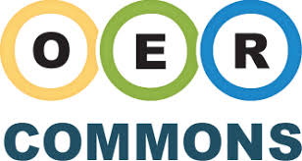
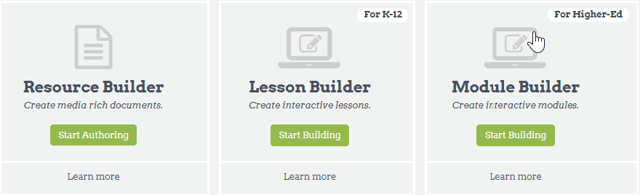
https://www.oercommons.org/

Slide 17

OER Commons: Advantages
Wide arc of options -- Can search for specific resources, collections of resources or collection providers.
Don’t have to work alone: Groups provides a flexible environment to organize, create, share, and discuss resources with others in various public or private networks.
Is customized to meet current OER needs and gaps unique to your organization. Curricula can be tailored to your instructional needs and areas of special interest.
Training even at our advanced ages can’t hurt! The Institute for the Study of Knowledge Management in Education (ISKME) provides continuous learning, collaboration in many areas, including OER, and has partnership with the OER Commons.

Slide 18


https://ocw.mit.edu/index.htm
Materials from 2,400 course
300,000,000 visitors
MIT OpenCourseWare (OCW) is a web-based publication of virtually all MIT course content. OCW is open and available to the world and is a permanent MIT activity.
K-12 and Education content available
Notes:
“The idea is simple: to publish all of our course materials online and make them widely available to everyone.”
Dick K.P. Yue, Professor, MIT School of Engineering

Slide 19

https://openstax.org/
Catchphrase: Open books. No catch
OpenStax is a nonprofit educational initiative based at Rice University, and it's our mission to give every student the tools they need to be successful in the classroom.
STAX publishes high-quality, peer-reviewed, openly licensed college textbooks that are absolutely free online and low cost in print. Seriously.
Notes:
As a leading research university with a commitment to unconventional wisdom, Rice University generates innovative research, excellent teaching, and creative contributions for the betterment of our world. OpenStax supports this vision by improving access to high-quality education for students everywhere.

Slide 20

https://www.merlot.org
The MERLOT collection consists of 10,000+ discipline-specific learning materials, learning exercises, together with associated comments, and bookmark collections, all intended to enhance the teaching experience of using a learning material.
All the materials in MERLOT are reviewed for suitability for retention in the collection. Many undergo the more extensive "peer review" for which MERLOT is famous.
The Content Builder tool works like that in the OER Commons: create and store your lessons or courses here, and share them if you please.
Notes:
The MERLOT project began in 1997, when the California State University Center for Distributed Learning (CSU-CDL at www.cdl.edu) developed and provided free access to MERLOT (www.merlot.org).
In 1999, the four systems recognized the significant benefits of a cooperative initiative to expand the MERLOT collections, conduct peer reviews of the digital learning materials, and add student learning assignments. Each system contributed $20,000 in cash to develop the MERLOT software and over $30,000 in in-kind support to advance the collaborative project. The CSU maintained its leadership of and responsibilities for the operation and improvement of processes and tools.
In January, 2000, the four systems sponsored 48 faculty from the disciplines of Biology, Physics, Business and Teacher Education (12 faculty from each of the four systems) to develop evaluation standards and peer review processes for on-line teaching-learning material. In April, 2000, other systems and institutions of higher education were invited to join the MERLOT cooperative. In July, 2000, twenty-three (23) systems and institutions of higher education had become Institutional Partners of MERLOT. Each Institutional Partner contributed $25,000 and in-kind support for eight faculty and a project director (part-time) to coordinate MERLOT activities. The CSU continued its leadership of and responsibilities for the operation and improvement of processes and tools.

Slide 21

http://www.openculture.com/
1,300 Online courses
1,500 Movies
Audio books
Plus: audio books, e-books, textbooks, language lessons & more
Open Culture the web for the best educational media. He finds the free courses and audio books you need, the language lessons & movies you want, and plenty of enlightenment in between.
Notes:
1,300 Free Online Courses from Top Universities
1,150 Free Movies Online: Great Classics, Indies, Noir, Westerns, etc.
900 Free Audio Books: Download Great Books for Free
800 Free eBooks for iPad, Kindle & Other Devices
MOOCs from Great Universities (Many With Certificates)
Learn 46 Languages Online for Free: Spanish, Chinese, English & More
200 Free Kids Educational Resources: Video Lessons, Apps, Books, Websites & More

Slide 22
To wit:
Reducing students’ cost of education requires an initial expenditure of time and energy from faculty and suggesting otherwise is misleading.
There are examples of entire districts expending the time and effort needed for the conversion but these are the exception.
My guess is that most teachers care deeply about children’s education and are more likely to take the step that is the average politician or lawyer.
Still it can’t hurt to talk with your peers and see if a department, school, or district effort is possible.
Finally, OER is less time consuming with some bootstrapping, and that’s what where I can help.

Slide 23

Start: Planning!
How to you start a garden:
with a shovel or with a plan?!
The course
Subject
Course outline
Materials
Notes:
Ask victims how they plan a new course

Slide 24

Questions?
Robert Alan Harris
harrisr@wpunj.edu
https://www.wpunj.edu/irt/ctt/oer/
Presentation
http://bit.ly/wpu-oer-022019
Bibliography
http://bit.ly/wpu-oer-biblio
Resources
http://bit.ly/wpu-oer-resources

Slide 25

Yes, we can!
A hands-on approach to
Open Educational Resources
2018-11-29/30
Robert Alan Harris, Assistant Director
Center for Teaching with Technology
Library 120H – harrisr@wpunj.edu – 973-720-2451
William Paterson University, www.wpunj.edu

